Slide 1
Big Skinny
Jun Kim, Abhi Maddineni, Roy Xu, Evan Zeng
67-250: Information Systems Milieux
Spring 2019

Slide 2
Porter’s Five Forces
Strategic Analysis
Product Differentiation
Industry Competition
Threat of Substitutes
Potential of New Entrants
Power of Suppliers
Microfiber Nylon
Power of Consumers
Display Advertisements
Algorithmic Search
Sponsored Search
Interactive Content
Online Distributors
A/B Testing
Social Media

Slide 3
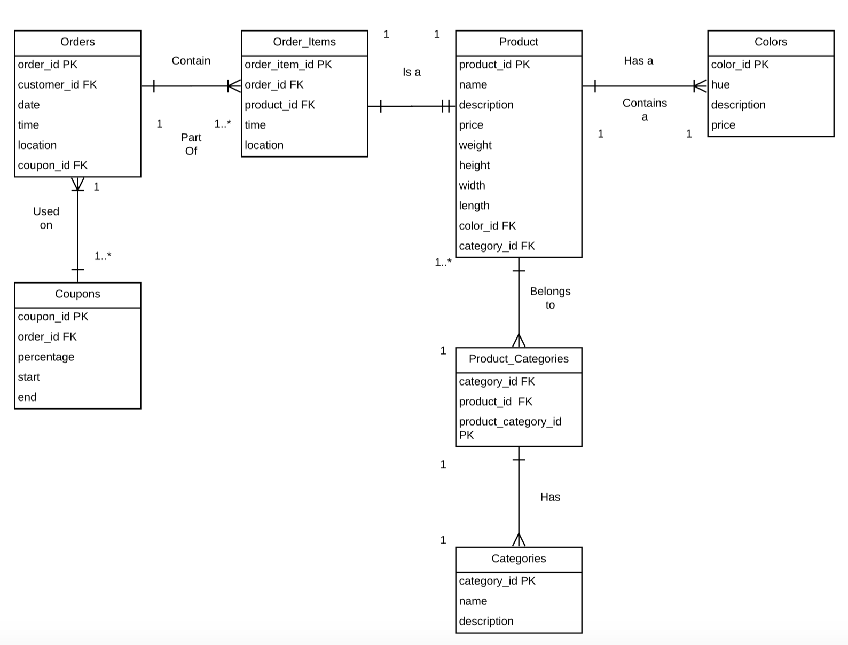
Recommendations
ERD
Search Analytics
Google / Bing analytics
SEO
Supply Chain Management
Poor delivery mechanisms
Amazon warehousing
Customer Relations Management
Customer issues
In-house platform
Salesforce

Slide 4
Website Demo
http://royxu.me/Big_Skinny/

Slide 5
Discussion!

